Slide 1
Selective Kernel Networks
Xiang Li∗1,2, Wenhai Wang†3,2, Xiaolin Hu‡4 and Jian Yang§1
Notes:
第一页

Slide 2
Abstract
We propose a dynamic selection mechanism in CNNs that allows each neuron to adaptively adjust its receptive field size based on multiple scales of input information.
Selective Kernel (SK) unit is designed, in which multiple branches with different kernel sizes are fused using softmax attention that is guided by the information in these branches. Different attentions on these branches yield different sizes of the effective receptive fields of neurons in the fusion layer.
Notes:
第二页

Slide 3
Introduction
(SK) convolution, which consists of a triplet of operators: Split, Fuse and Select.
Split：generates multiple paths with various kernel sizes which correspond to different RF sizes of neurons.
Fuse: combines and aggregates the information from multiple paths to obtain a global and comprehensive representation for selection weights.
Select: aggregates the feature maps of differently sized kernels according to the selection weights.

Slide 4
Related Work
Muti-branch convolutional networks:
Grouped/depthwise/dilated convolutions:
In SK convolutions, the kernels of larger sizes (e.g., >1) are designed to be integrated with the grouped/depthwise/dilated convolutions, in order to avoid the heavy overheads.
Attention mechanisms:
SENet brings an effective, lightweight gating mechanism to self-recalibrate the feature map via channel-wise importances.
Dynamic convolutions:
SKNet the RF sizes of neurons can adaptively change during inference.

Slide 5
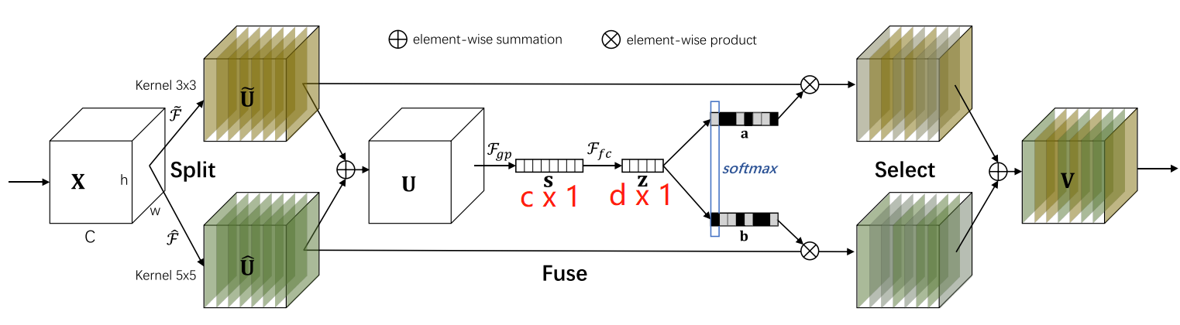








Methods
r is a control ratio, L denotes the minimal value of d

Slide 6
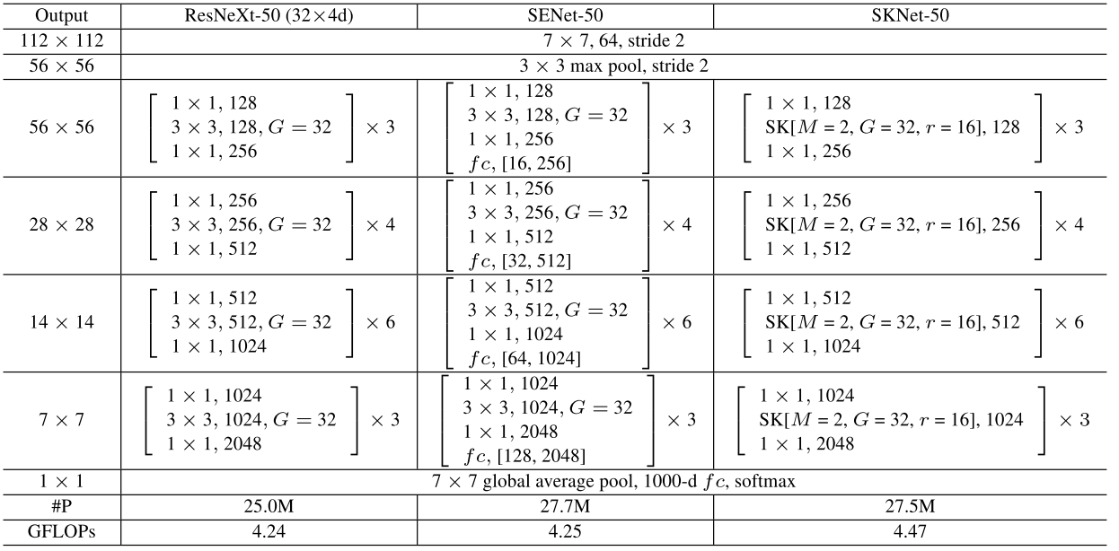
Network Architecture:
M:path, G:conv group number, r:d reduction ratio

Slide 7
Experiments
ImageNet Classification

